Slide 1


Introduction to the INCOSE Corporate Advisory Board (CAB)
International Council on Systems Engineering
A better world through a systems approach
incose.org

Slide 2


Slide 3
Agenda
INCOSE Overview
INCOSE Corporate Advisory Board (CAB)
CAB Membership Opportunities and Products
Conclusion

Slide 4





Impact of INCOSE
With over 30 years of experience, we are shaping the future of systems engineering.
INCOSE is the premier choice of systems engineers for professional development.
We interact with systems engineers across the globe on a daily basis to advance the state of the profession/discipline
21,000+
Members and CAB Associates
130+
Corporate Members
50+
Working Groups
65
Chapters Worldwide
75
Countries Worldwide

Slide 5




Vision and Mission
Vision
A better world through a systems approach.
Mission
To address complex societal and technical challenges by enabling, promoting, and advancing Systems Engineering and systems approaches.
Objective
Global leader for systems engineering professionals for career development.
Future
Lead the future of systems engineering, academically, in emerging domains, and in practice.

Slide 6
Why Join INCOSE
INCOSE is the global Systems Engineering professional society – providing the opportunity for life-long learning in systems approaches.
A community of peers, resources for your career, and a place
to be a leader.
INCOSE members stand out and are often sought after as experts.
INCOSE members share practices and learn from each other.
INCOSE members create products, produce events and represent
the organization in international forums.
INCOSE members increase the body of knowledge and advance
the practice of systems engineering.
Network with over 21,000+ members in 75 countries.
Increase your professional stature with the INCOSE Systems Engineering Professional Certification.

Slide 7







Membership Benefits
A global network of colleagues who understand systems engineering
Collaborate with experts and practitioners worldwide
Certification Opportunities
Exclusive access to INCOSE Connect, the collaborative space for INCOSE Members Only
Access to quarterly e-Publications, INSIGHT and Journal of Systems Engineering
Member discounted registration to the International Workshop and International Symposium.
Electronic version of the Systems Engineering Handbook

Slide 8

Corporate Advisory Board (CAB) Introduction
Corporate Advisory Board membership allows organizations to guide the direction of the SE discipline.
Members and Associates gain access to state-of-the-art products.
Align with peers and fellow industry leaders, grow your global footprint, and learn about how other industry leaders are applying systems engineering to solve business problems.
Gain better access to talent - find and hire competent, certified Systems Engineers through your INCOSE connection
INCOSE Corporate Advisory Board (CAB) is the Voice of the Customer to INCOSE leadership.
Shape INCOSE Strategic Direction
Report SE challenges facing industry and academia
The CAB provides strategic guidance to technical leadership, leading to the development of systems engineering products and input to standards
Identify CAB Needs
Support and mentor working groups with recommendations for product priorities

Slide 9




Academic Council Introduction
Academic Council members form the branch of the Corporate Advisory Board facilitating discussion and exploration of issues relevant to academia and setting a path for achievement with strategic collaborations within INCOSE.
The CAB has 38 Academic Members in 9 countries
Council member organizations offer bachelors, masters and doctorate degrees in systems engineering and related programs
Advance state-of-the-art systems engineering through academic programs
Some of the benefits of Academic CAB Membership include:
Opportunity to apply for certification Academic Equivalency for appropriate courses.
Opportunity to network and collaborate with other academic institutions globally, related to systems engineering.
Opportunity for internships, externships​, and employment offers.
Research collaborations with other Academic Council member organizations.

Slide 10

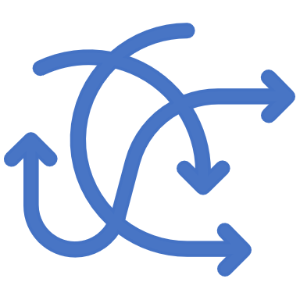

What is a CAB Member?
CAB Members are the customer’s voice to INCOSE Leadership’ highlighting the Systems Engineering needs.
The CAB helps INCOSE to
  Investigate important Systems Engineering (SE) challenges facing the industry and government
  Shape INCOSE’s strategic direction
    Identifying and prioritizing the best ways to advance the discipline of SE in industry, science, and academia
Support and mentor INCOSE’s more than 50 Working Groups with recommendations for products determining priorities

Slide 11
CAB Metrics
There are currently 132 CAB Members
Every organization has equal input
Organizations by Size
Organizations by Category
Stats correct on June 14, 2023

Slide 12
Current CAB Members (By Type)
Industry
Aerospace Corporation​ (The)
Airbus ​Group
AM General LLC​
Analog Devices, Inc.​
Aras Corp
Arc Field ​
Aviage Systems ​
Aviation Industry Corporation of China, Ltd.​
BAE Systems
Ball Aerospace​
Bechtel​
Becton Dickinson​
Belcan Engineering Group
The Boeing Company ​
Booz Allen Hamilton Inc.​
Bombardier Transportation
CACI International​
Change Vision, Inc.​
C.S. Draper Laboratory, Inc.​
Cubic Corporation​
Cummins, Inc.​
Cybernet MBSE​
Dassault Systemes​
Deloitte Consulting​
DENSO Create, Inc.​
Embraer S.A.​
Ford Motor Company​
Fundacao Ezute​
General Electric Aviation​
General Dynamics
General Dynamics Mission Systems​
General Motors​
IBM​
ISDEFE​
iTiD Consulting, Ltd​
IVECO SPA​
Jama Software
Jet Propulsion Laboratory​
John Deere & Company​​
KBR, Inc.​
L3 Harris​
Leidos​
Lockheed Martin Corporation​
ManTech International Corporation​
MBDA (UK) Ltd.
MetaTech Consulting, Inc.​ ​
The MITRE Corporation​
Mitsubishi Heavy Industrials ​
Modern Technology Solutions, Inc.​
National Solutions Group, Inc.
Nissan Motor Co, Ltd ​
Northrop Grumman Corporation​
​Peraton​
Petronas Nasional Berhad​
Prime Solutions Group, Inc.​
Project Performance International​
QRA Corporation ​
Raytheon Technologies​
Rolls Royce
SAAB AB​
SAIC
Sandia National Laboratories​
Saudi Railway Company​
Shell​
Sierra Nevada Corporation​
Siemens​
SPEC Innovations​
Strategic Technical Services
Systems Planning and Analysis​
TATA Consultancy Services​
Thales​
Toch Technologies​
Trane Technologies​
Toshiba Corporation​
Veoneer, Inc​
VG2PLAY​
Vitech
Volvo Cars Corporation​
Volvo Construction Equipment ​
Wabtec​
Woodward Inc ​
Zuken
Government​
Federal Aviation Administration (U.S.)​
Idaho National Laboratory​
Lawrence Livermore National Laboratory​
Los Alamos National Laboratory​
National Reconnaissance Office​
National Aeronautics and Space Administration​ (NASA)
National Reconnaissance Office (NRO)
National Security Agency – Enterprise​
Pacific Northwest National Laboratories​
Swedish Defence Materiel Administration​
Taiwan Space Agency ​
UK MoD​
US Department of Defense​
Academic​
Australian National University​
California State University Dominguez Hills ​
Carnegie Mellon University Software Engineering Institute​
Colorado State University​
Cornell University​
Cranfield University​
Defense Acquisition University​
Drexel University​
Eindhoven university of Technology​
George Mason University​
Georgia Institute of Technology​
​ISAE SUPAERO​
John Hopkins University​
KEIO university​
Loyola Marymount University​
Mahindra University​
Marquette University​
Massachusetts Institute of Technology​
Missouri University of Science & Technology​
Naval Postgraduate School​
Penn State University​
Purdue University​
Singapore Institute of Technology​
Stevens Institute of Technology​
University of Arizona​
Tsinghua University​
Virginia Tech​
Worcester Polytechnic Institute​
University of:​
  Alabama in Huntsville​
  Arkansas​
  California San Diego​
  Connecticut​
  Maryland​
  Maryland, Baltimore County​
  Maryland Global Campus​
  Michigan, Ann Arbor​
  New South Wales, Canberra​
  Southern California​
  Texas El Paso​
Stats correct on June 2, 2023

Slide 13



CAB Leadership & Meetings
The CAB has a Chair and a Co-Chair. The Chair is a two-year position and is a voting member of the INCOSE BoD. The Co-Chair is elected by the CAB at the International Workshop from those candidates nominated from CAB organizations. The Co-Chair-Elect is installed as the Chair after two years.
The CAB holds meetings twice a year in conjunction with the International Workshop (IW) and International Symposium (IS). On the months apart from the IW and IS, the CAB holds a regular monthly meeting.
The CAB makes notes and presentation material of all meetings available to the INCOSE Board of Directors. CAB members have access to a dedicated INCOSE website and Viva Engage (previously Yammer) Community.

Slide 14
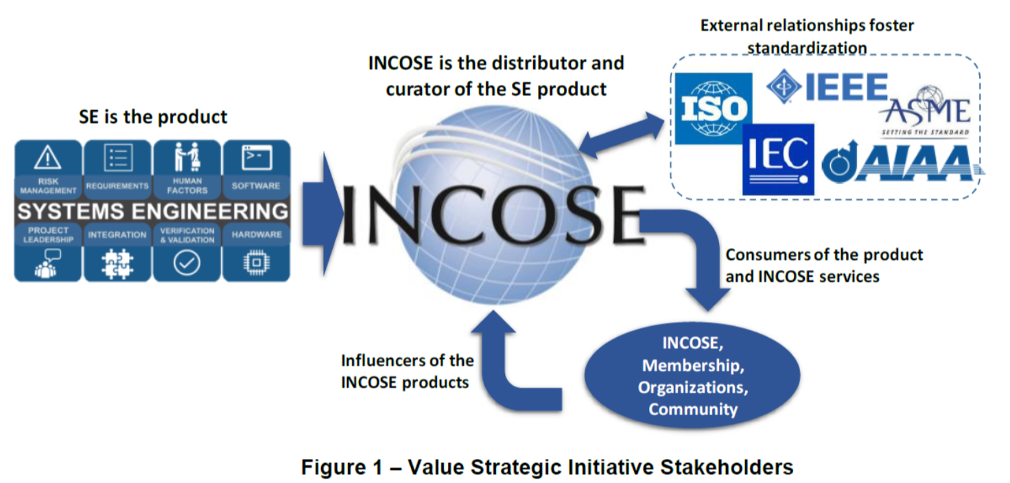
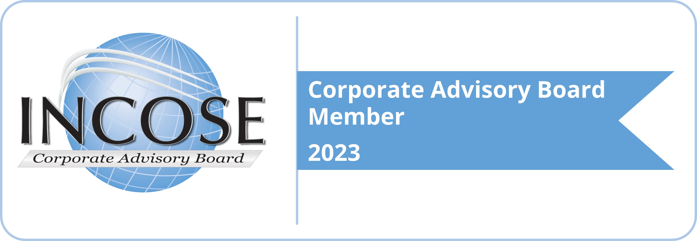


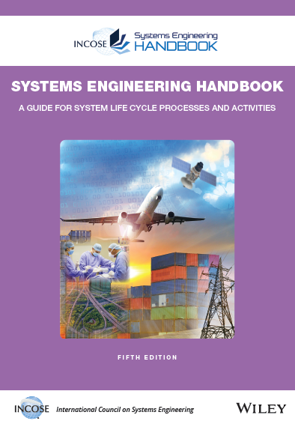




Lifecycle of the CAB Impact
CAB organizations influence INCOSE work and benefit from INCOSE products
INCOSE Vision and Strategic Plan
External Organizations
CAB Member Organizations
CAB needs are briefed annually to the INCOSE Board of Directors and the Technical Director; Needs are flowed to the appropriate workgroups for action
INCOSE Products and Services
Working Groups and Technical Services deliver product solutions that further the systems engineering discipline consistent with the INCOSE Vision, Strategic Plan while addressing CAB Needs
Products
CAB member organizations, CAB Reps, and CAB Associates identify and document CAB needs annually based on challenges facing industry and academia
Value Streams / Working Groups
Events
CAB Members help to Lead, Support, and Mentor Working Groups
Certification

Slide 15



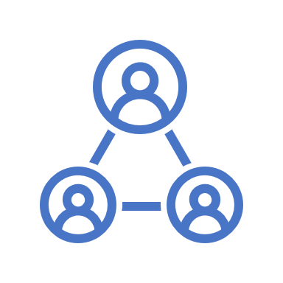

Key CAB Members Benefits
Recognition on the INCOSE CAB home page with a link to the organization.
Complimentary Registration at the International Symposium.
The designated representative of each CAB member is granted full INCOSE membership for the years they serve as their organization’s CAB representative.
Opportunity to submit candidates for one of 10 allocated CAB slots for INCOSE’s Institute for Technical Leadership.
Complimentary functions for CAB member representatives who attend the business meetings hosted by INCOSE with the INCOSE Board of Directors in attendance to promote networking and goodwill (e.g. CAB Dinner at IS, INCOSE Foundation Event at IW).
Reduced rates on selected advertising within INCOSE, recognition in selected INCOSE publications and ability to participate in virtual job fairs for SEs.

Slide 16
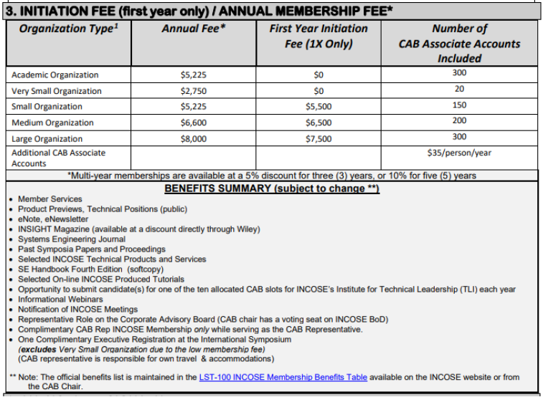
CAB Organization Membership Costs
CAB Membership Fees are Annual based on Organization Size
  Multi-year membership - 3yrs., 5% discount
  Multi-year membership - 5 yrs., 10% discount
CAB Membership requires a first year non-recurring initiation fee
CAB Memberships include CAB Associate Accounts included at no additional costs
  CAB associate accounts allow organization members access to many of the INCOSE Products with the goal that they transition to full members and further consider SE certifications
Membership fee depends on the size of the CAB organization. Also discounts for international CAB members in certain countries with low incomes.

Slide 17
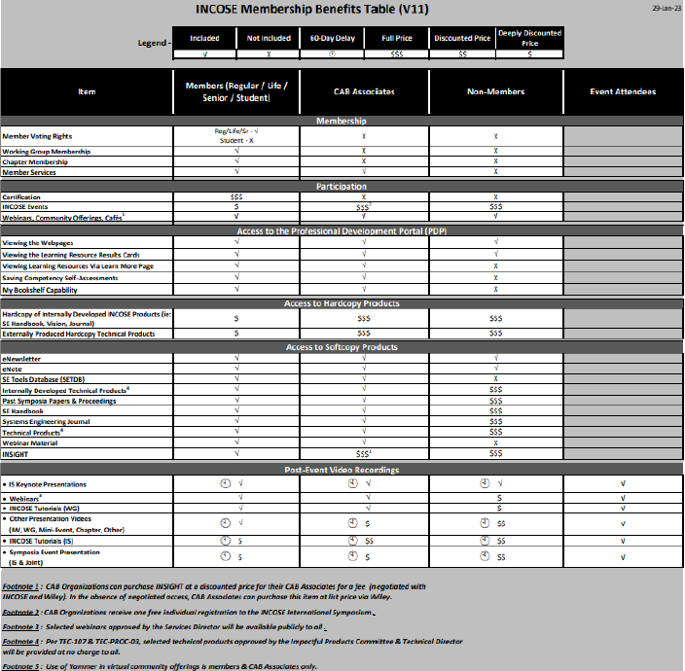
CAB Associate Membership Benefits
CAB Associates have access to Member Services
Participation in Webinars and SE Community Offerings
Access to the Professional Development Portal
Access to many current and archived softcopy products
Video recordings of INCOSE Tutorials and keynote IS Presentations (Delayed)

Slide 18
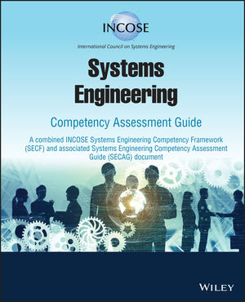
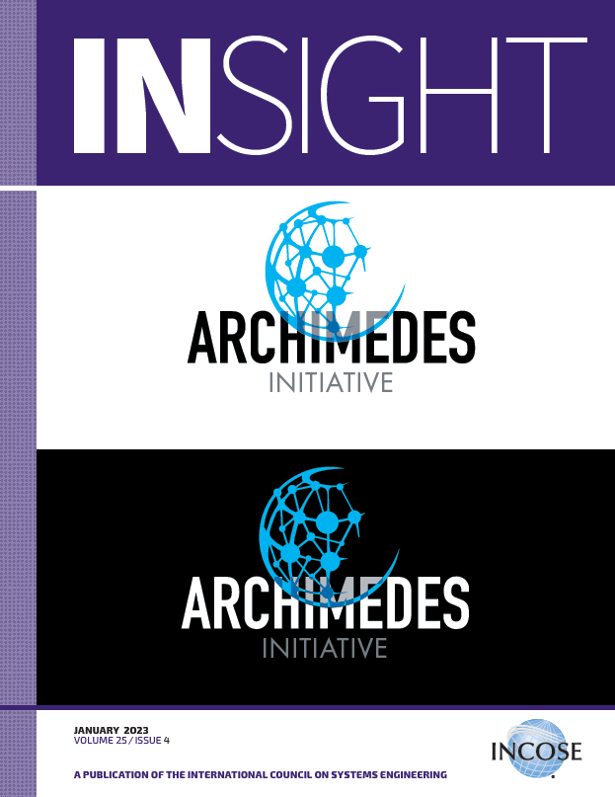

CAB Membership Opportunities
Products
Systems Engineering Vision 2035
INSIGHT Magazine*
Guides
INCOSE SE Handbook
Members Newsletter
Systems Engineering Journal
*Available for an extra fee

Slide 19


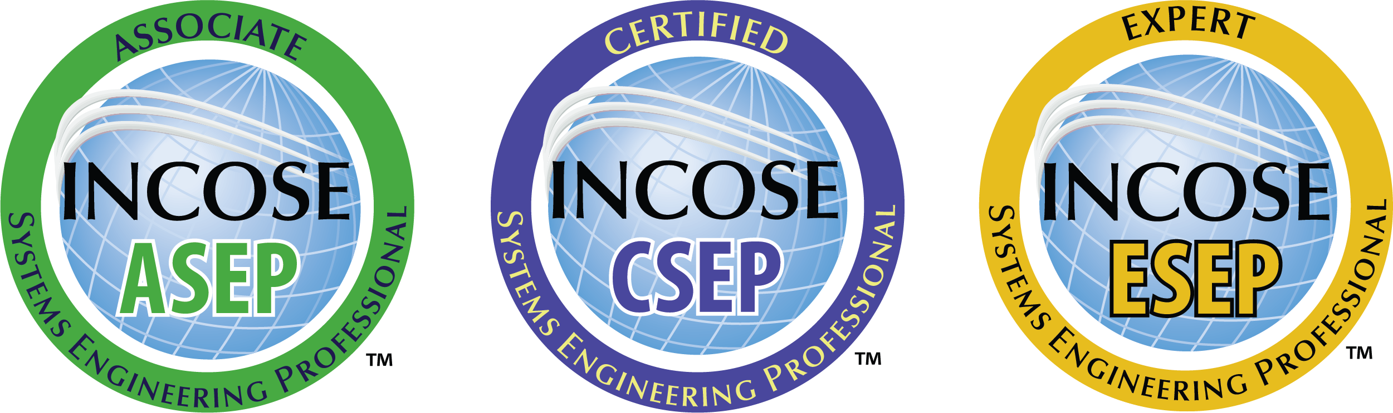



CAB Membership Opportunities
Professional Development (*Full Membership required)
Professional Development Portal (PDP)
Technical Leadership Institute *
Certification *
Systems Engineering Body of Knowledge
Systems Engineering Tools Database
Mentoring

Slide 20
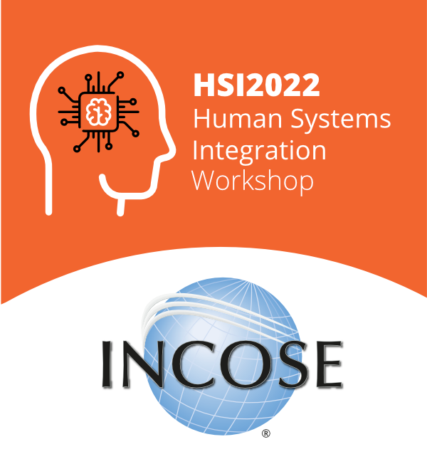





CAB Membership Opportunities
Conferences and Events
Annual International Symposium
Annual International Workshop
Regional Events
Europe, Middle East,
Africa (EMEA) Workshop
and Systems Engineering Conference (WSEC) 2023
Virtual Community Events & Webinars
Working Groups & Initiative Events and Meetings

Slide 21




CAB Membership Opportunities
Working group Membership (Full Membership required)
INCOSE's over 50 active working groups include:
Agile Systems and Systems Engineering
Architecture
Artificial Intelligence Systems
Automotive
Competency
Complex Systems
Configuration Management
Critical Infrastructure and Recovery
Decision Analysis
Defense Systems
Digital Engineering Information Exchange
Empowering Women
Enterprise Systems
Healthcare
Human Systems Integration
Information Communications Technology
Infrastructure
Integration, Verification & Validation
MBSE Initiative
Natural Systems
PM-SE Integration
Product Line Engineering
Requirements
Smart Cities Initiative
Social Systems
Space Systems
Systems Safety
Systems Engineering and Lawmaking
Systems Engineering Quality Management
The value of working groups:
Working groups are the resource practitioners need.
Discuss, collaborate, share in person, and online with a wide diversity of interests.
Help develop and review international standards
Create products to advance the state, art and practice of systems engineering.
WGs run events, workshops, panels and much more

Slide 22
Conclusion
As a CAB Member Organization you:​
Help INCOSE to shape the Systems Engineering landscape
Network with worldwide SE industry leaders and CAB colleagues
Influence INCOSE Working Groups which develop future SE processes, procedures, and products
Have access to extensive INCOSE resources through your CAB Associates and full members
Demonstrate your organization’s commitment to systems engineering
www.incose.org/cab

Slide 23
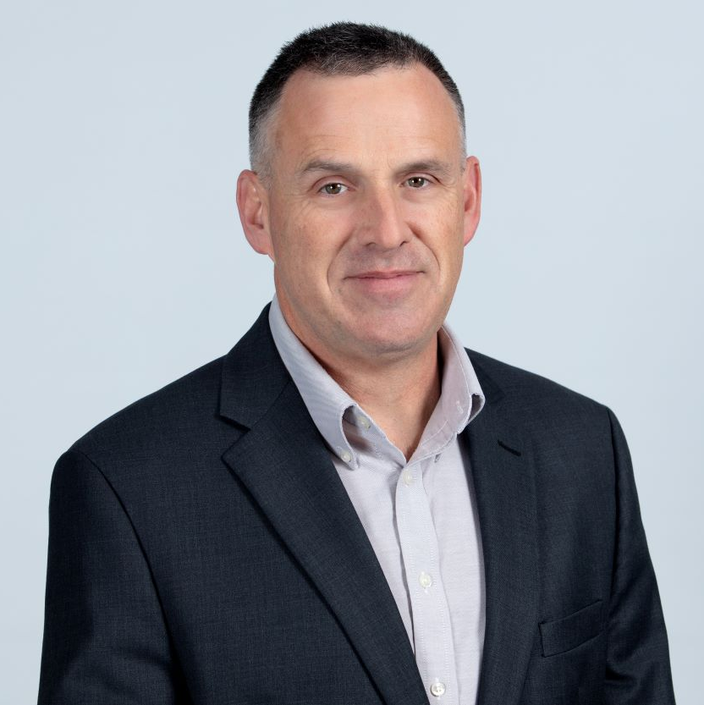
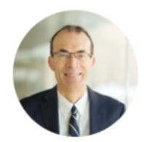
Let’s connect
Mike Dahlberg
CAB Chair
michael.dahlberg@incose.net
www.incose.org/cab
Bob Bordley
CAB Co-Chair
robert.bordley@incose.net

Slide 24

Thank you

Slide 25





Contact Us
International Council on Systems Engineering
A better world through a systems approach
For more information contact cab-inquires@incose.net
www.incose.org/cab
@INCOSE
@incose_org
@incose_org
INCOSE

