Slide 1

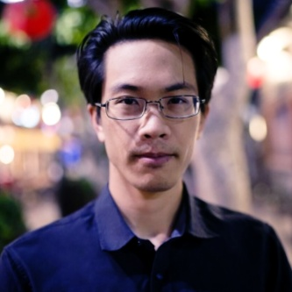
INCOSE-LA September 10, 2019 Speaker Event
Abstract
OpenMBEE is an open source community-driven Model-Based Engineering Environment, with several major organizations leading its development, including JPL, Boeing, and Lockheed Martin. Unlike most proprietary Model-Based Engineering software suites, OpenMBEE is free to use, dominantly licensed under Apache 2.0, inherently designed to serve multiple modeling languages as well as a variety of techniques for model checking, simulation, and document generation. OpenMBEE GitHub has a variety of open source projects supporting this pursuit as well as open source models and model libraries contributed by the community, including, but not limited to plugins or extensions for commercial tools, such as SysML desktop clients like MagicDraw, light-weight web-based client like View Editor, mathematical computation programs like Mathematica, and any other tool that can utilize RESTful web services. With infrastructure for versioning, workflow management, and access control, OpenMBEE facilitates multi-tool and multi-repository integration across engineering, computing, and management disciplines.
Bio
Sean Marquez graduated with a B.S. in Mechanical Engineering, specializing in design of dynamic systems, from UC Irvine in 2013. After graduating, he worked as an associate mechanical design engineer for Max Q Systems – an OEM aerospace consulting firm. In 2015, he joined and collaborated with a global think tank, performing numerical simulations & control systems design for rLoop – a non-profit organization that competed and won the innovation award for the first SpaceX hyperloop pod competition. Sean currently does software & systems engineering at Space Cooperative Inc. – a worker-owned cooperative focused on space expansion, crewed by a diverse global team that includes engineers, architects, futurists, and software developers.
Sean Marquez
TOPIC: OpenMBEE: an Open Source Model-Based Engineering Environment
WHERE: HOST SITE: The Aerospace Corporation, 200 North Aviation Blvd., Bldg. D8, Room 1010 El Segundo, CA 90245
Host: Deborah Cannon, 310-336-8341 (Office), 714-477-3755 (Cell)
REGISTRATION LINK: http://events.constantcontact.com/register/event?llr=l4ihvgeab&oeidk=a07egixa0wq33b99d33
  ATTENDANCE: Virtual or In-Person

