Slide 1
INCOSE.ORG MIGRATION
SharePoint 2013
Presented by Betty Morimoto

Slide 2
Agenda
Target Audience for this Training - Working Group & Chapter Leaders
3 Technologies Migrated:
  Member Database
  Public Site (INCOSE.ORG)
  Member Only Intranet (CONNECT)
New Features of 2013 (FOLLOW, Newsfeed, INCOSE Restructured Menus)
New Terminology Same SharePoint (Web Parts are called Apps)
Adding an App to your Site
New and Improved SharePoint Search

Slide 3
Target Audience for this Training -
Working Group & Chapter Leaders
SharePoint is organized in 3 Levels of Access Rights
  Owners – who are Administrators, Chapter & Working Group Leadership
  Members – who are Contributors, Chapter & Working Group Members
  Visitors – All INCOSE Members, Read-Only
Your Membership and Position within INCOSE will drive your Access Rights within the New CONNECT
These assignments are estabilished in the Member Database by INCOSE Central Office and through the Member Portal by Joining a Chapter or Working Group
Access rights are NEVER configured from within CONNECT as was in the old CONNECT
Logging into CONNECT from Sitefinity uses Single Sign On (SSO) communication between the Member Database, SharePoint and Sitefinity
If you find that you do not have the access that you should, please contact INCOSE Central Office

Slide 4
Background of Technology used for this Migration Effort
Our focus for this training will be with SharePoint 2013, for Member Collaboration
Member Database
Sitefinity (INCOSE.ORG)
SharePoint 2013 (CONNECT)

Slide 5
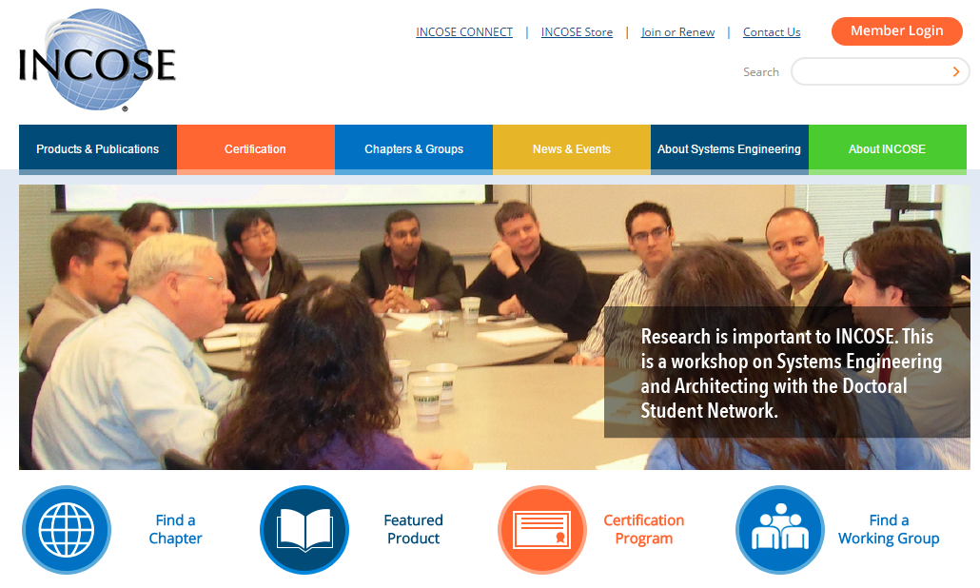
Sitefinity Website, beta.incose.org
News / Events / Public Information
Click the Member Login button and login with your INCOSE email and password

Slide 6
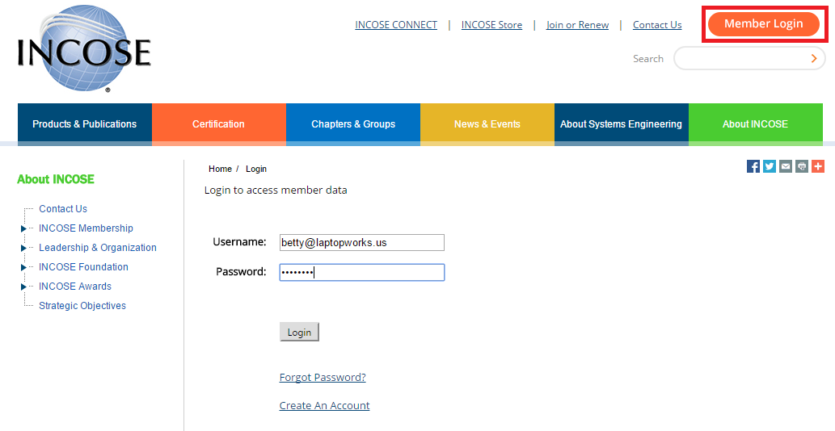
Click Member Login then Click the INCOSE CONNECT Link

Slide 7
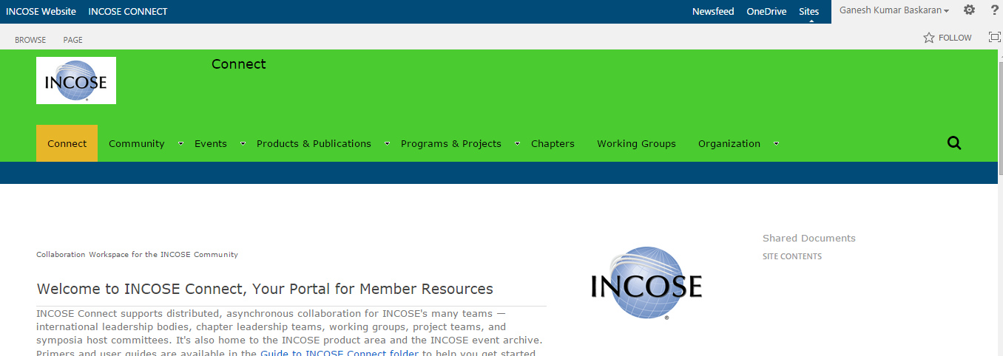
SharePoint 2013 – CONNECT Site
Member Only Area / Collaboration

Slide 8
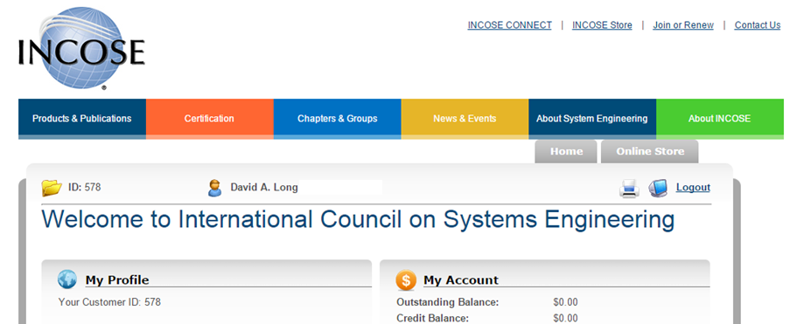
MemberSuite – Member Database for
Renewal / Join WG / Shop / Products

Slide 9
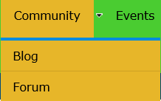
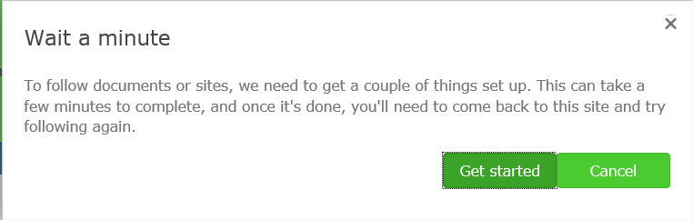
SharePoint 2013 is SO MUCH better than the Old CONNECT!
Like Twitter, you can FOLLOW Sites and People
By following content, it will be available to access in the Newsfeed link
Blogs and Forums on the Main CONNNECT Community Menu Drop-down
  Blogs are similar to Forums (Discussion Lists) but Blogs are generally a single individual’s opinion with collaborated responses, or comments from others, whereas Discussion Lists are contributed by the population with equally weighted contributions
  Bill Chown our new CIO will delegate the use and direction of the Blogs and Forums, Chapter and Working Group’s Discussions Lists will be delegated by their appropriate leadership
When you first FOLLOW a site, you will be prompted to set it up.

Slide 10
What is a Web Part, App, List, Library?
Terminology, Terminology, Terminology – Microsoft use to call all of the parts of the a SharePoint Site a Web Part, now in SharePoint 2013 they call them Apps
SharePoint sites may contain:
  Other Subsites, children sites
  Pages areas to organize content. A meeting may have a filtered agenda and a document library, for example. You can publish these web parts together on a single page and distribute the URL to your attendees for easy access
  Web Parts such as Lists, Document Libraries, Calendars, Discussion Board (FORUM), Announcements
  The Site Content link will allow you to view all of the Web Parts/Apps available to the site
  If your site does not have a Web Part / App you need, add it to your site

Slide 11
As in Previous Versions of SharePoint, Documents are Checked Out & In
Collaboration is an important part of business and Sharing Documents amongst a population of editors can be challenging
The communication of who is currently modifying a public document is handled by the “Library System” of Checking Documents Out & In
Imagine a book in a Public Library, once the book has be checked out by someone you can’t get it until that individual returns the book, or checks it back in
SharePoint is a little better in that you can “Read” the old version of the document if is checked out by someone
Typically you will only Check Out the document with the intention of modifying it but after you are done with the modifications, Checking the document back into the library will make the new version available to all

Slide 12
Adding an App to Your Site
To add an App such as a Custom List or Discussion List to your site, you must have Owner rights to the site. Chapter and Working Group Leaders have been granted Owner / Administrator privileges to their own site.
First Navigate to the Chapter or Working Group Site you wish to add the new App to
Access the “Gear” icon to the right of your name in the top right corner of the screen and choose the Add an app option, or navigate to SITE CONTENT and choose the Add an App option
If the Add an App option does not display, you do not have Owner rights to modify the current site. If you believe that you should be able to modify the site, please contact IT-Eval@incose.org

Slide 13
New SharePoint Search Available
SharePoint’s Search is still in the process of “fine tuning” in our Beta environment as of IW 2015
Single Sign On (SSO) should only ask for your credentials once, if you are prompted to enter your user name and password when searching, please do so. This is a known bug and should be corrected before Go Live
Currently the search for People is limited to those who have accessed / Logged into CONNECT
We hope to integrate the Member Database into SharePoint however this implementation has not completed as of IW 2015

Slide 14
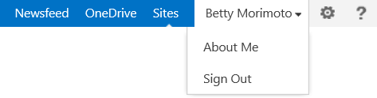
Signing Out of SharePoint
It is always a good idea to Sign Out
Click your name in the top right corner and choose the Sign Out option

Slide 15
Thank you!
I hope you are as excited about our new IT platform as I am!
If you have any questions or concerns about what was covered in this session, please contact INCOSE Central directly or email
IT-Eval@incose.org

