Slide 1
INCOSE.ORG MIGRATION
Chapter Webmaster
Training
Presented by Betty Morimoto

Slide 2
Agenda
Target Audience for this Training -
Chapter Webmasters
3 Technologies Migrated:
  Member Database
  Public Site (INCOSE.ORG)
  Member Only Intranet (CONNECT)
Chapter Areas in INCOSE.ORG and CONNECT
Important Facts
  URLs, User Chrome, Only 10 concurrent licenses, You have 2 User Names & Password
Steps to Logging into Sitefinity’s Backend Admin Area
Finding my Chapter Site Pages
Create Chapter Image Libraries, not Document Libraries, Chapter Document Libraries are already available
Chapter Specific News & Events Using Categories for News and Events
Configure your Chapter Home, Chapter News and Chapter Events Pages Using Categories
Updating Home Page the Chapter Graphic
Modifying Content on the Chapter Page, helpful buttons
After you are done, before closing your browser, please Logout

Slide 3
Target Audience for this Training -
Webmasters of the following Chapter Sites
Alamo | Delaware Valley (Philadelphia, PA; PA/NJ) | Los Angeles | Snake River
Atlanta | Emerald Coast (Florida panhandle) | Michigan (Detroit, MI) | Southern Arizona (AZ)
Blues | Enchantment (Albuquerque, NM) | Midwest Gateway (St. Louis, MO) | Southern Maryland (Patuxent River, MD)
Brasil | Finger Lakes (Rochester, NY and environs) | New England (Boston, MA) | Space Coast (Melbourne, FL)
Central Arizona (Phoenix, AZ) | Great Plains | North Star (Twin Cities, MN) | Swedish Chapter
Central Savannah River Area (Aiken, SC) | Hampton Roads Area (Hampton Roads, VA) | Norway | Texas Gulf Coast
Central Virginia (Fredericksburg, VA) | Heartland (Cedar Rapids, IA) | Orlando (Orlando, FL) | Three Rivers (Pittsburgh, PA)
Chesapeake (Columbia, MD) | Huntsville (Huntsville, AL) | San Francisco Bay Area (Silicon Valley, CA) | Wasatch
Chicagoland (Chicago, IL) | India | Seattle Metropolitan (Seattle, WA) | Wright Brothers (Ohio)
Cleveland-Northern Ohio | Liberty (Whippany, NJ) | Singapore

Slide 4
Background of Technology used for this Migration Effort
Our focus for this training will be with Sitefinity, for modifying Chapter Sites
Member Database
SharePoint 2013 (CONNECT)
Sitefinity (INCOSE.ORG)

Slide 5
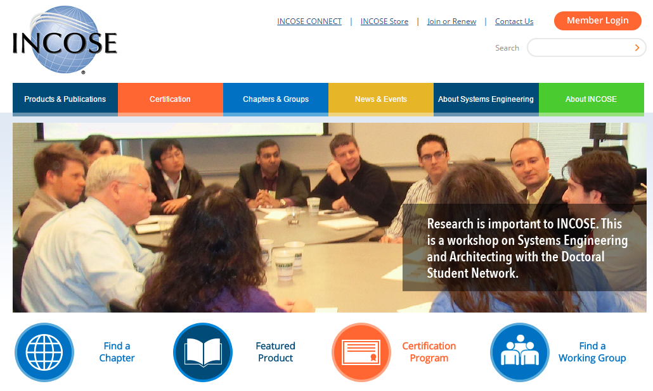
Sitefinity Website, beta.incose.org
News / Events / Public Information

Slide 6
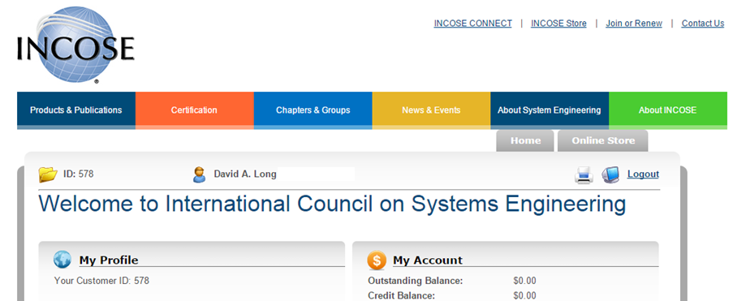
Member Databse (MemberSuite) Profile Page
Renewal / Join WG / Shop / Products

Slide 7
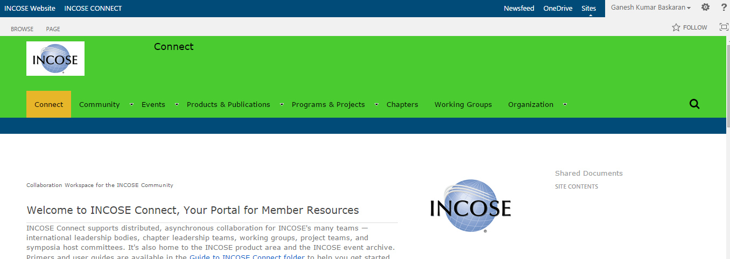
SharePoint 2013 – CONNECT Site
Member Only Area / Collaboration

Slide 8
Chapter Area in INCOSE.ORG
VS Chapter Area in CONNECT
Chapters at Go Live will have 2 areas where they will have a web presence, a site on INCOSE.ORG and a site on CONNECT
INCOSE.ORG is the site that is “Public Facing” and should contain content for not only INCOSE Members, but also for people who are interesting in Joining INCOSE and finding out more about your Chapter
INCOSE.ORG before Go Live is called beta.incose.org and to make changes to this new site, access beta.incose.org/sitefinity
CONNECT is the INCOSE Intranet site, available for Collaboration of your Chapter Members and visible to other INCOSE Members that may be interested in joining your Chapters

Slide 9
Where are my Working Group Pages?
Unlike Chapters, Working Groups will be given a page, not an entire site as with Chapters on the new INCOSE.ORG
Currently the Working Group Charters are displayed as downloadable PDF files rather than web pages http://beta.incose.org/ChaptersGroups/WorkingGroups
On CONNECT, is where each Working Group will be focusing their Web Presence for Collaboration purposes
INCOSE.ORG, currently before Go Live is beta.incose.org
This training will focus on the content on beta.incose.org

Slide 10
Important Facts to Consider Before Logging Into Sitefinity
URL to view your site before Go Live: beta.incose.org Backend URL before Go Live: beta.incose.org/sitefinity After Go Live, the URL’s will change to incose.org and incose.org/sitefinity, no “beta.”
It is STRONGLY recommended to use Google Chrome when modifying pages in Sitefinity. Pages can be viewed using any browser.
INCOSE is licensed to have only 10 concurrent users modifying pages in Sitefinity at a time. Due to this license limitation, it is critical that you LOG OUT when done so others are not locked out.
Do not confuse your Sitefinity Admin login with your INCOSE member login. You will have 2 different logins. You should never be logged in to both in the same browser. Log out of one before logging into the other.

Slide 11


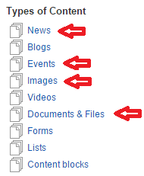

Logging into Sitefinity’s Backend Admin Area for Chapter Site Webmasters
Access your Chrome browser.
Navigate to beta.incose.org and verify that you are not logged in. The orange Member Login button should appear in the Top Right corner.
DO NOT CLICK THE MEMBER LOGIN BUTTON.
Type beta.incose.org/sitefinity in the Address Bar. This will take you to the backend Admin login screen.
Type the Administrator Username (Admin01 – Admin38) and password that was provided to you and click the Login button.
The Sitefinity Dashboard will appear. You will have the Pages and Content options to modify your Chapter pages.
From the Content menu, the Types of Content recommended are News, Events, Images, and Documents & Files.

Slide 12
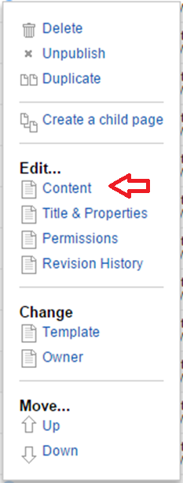
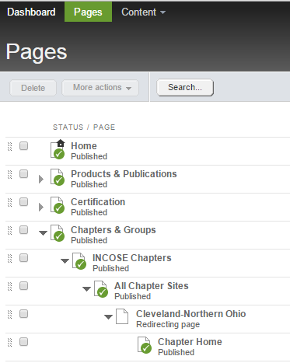
Finding my Chapter Site Pages
Pages > Chapters & Groups > INCOSE Chapters >
All Chapter Sites > “Your Chapter Name”
Click Pages
Click the triangle to open Chapters & Groups
Click the triangle to open INCOSE Chapters
Click the triangle to open All Chapter Sites
Scroll down the list and click the triangle to open “Your Chapter Name”
Click the link name Chapter Home, Chapter Events, Chapter News, Library and Resources, About This Chapter
The Actions link to the right of the page name opens a menu with more options. Clicking the link is equivalent to Edit… Content

Slide 13
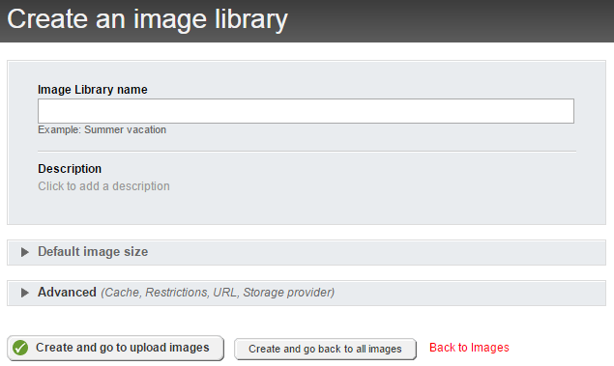

Before you begin editing a page upload your Images and Documents
Create your own Image Library to organize your images.
Name your images so they can be easily searched for before uploading. This makes it easier to insert on a page.
Click the Content menu
Click the Images option from the list
Click the Create an image library button
Prefix the library name with your chapter name, “India Chapter” for example.
If you want to upload your images, click the Create and go to upload images button.

Slide 14
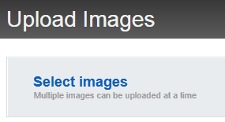
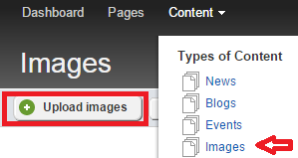

Uploading Images to an Image Library
If you just logged in, click the Content menu
Click Images
  Or if you just created the library you will be in the Images screen
Click the Upload Images button.
Click the blue link Select images
You can select multiple files by clicking the first file then holding down the [Ctrl] key and clicking to select the others, then click Open
Select the appropriate library you wish to add the images
Click the Upload and Publish button
Home Page Graphic Dimensions should be 670x280.

Slide 15
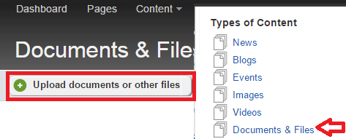
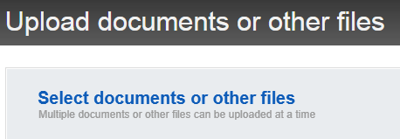
Different from Images, Chapter Document Libraries are already available
If you want to provide downloadable content for your members you can make it available in Sitefinity. Remember, this is a public site so Member Only content should NOT be stored here, use your CONNECT Chapter site.
It is not necessary to create a new Chapter Document Library. Each Chapter has their own library already established in Sitefinity.
Please store your content in your own library.
Click the Content menu
Click Documents & Files
Click the Upload documents or other files button
Click the blue link Select documents or other files
You can select multiple files by clicking the first file then holding down the [Ctrl] key and clicking to select the others, then click Open
Select the appropriate library you wish to add the documents
Click the Upload and Publish button

Slide 16


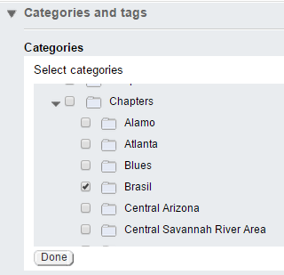


Creating Chapter Specific News & Events
Creating a New News Item
Creating a New Event
Click the Content menu
Click the News option
Click the Create a news item button
Specify the Title and other details
Select the Category, Chapter and check your Chapter Name, click Done
Click More actions to publish on a different date
News items, different from Events are usually sorted by Publish Date
Click the Content menu
Click the Event option
Click the Create an event button
Specify the Title and other details like the Start/End date, Location, and Time Zone
Select the Category, Chapter and check your Chapter Name, click Done
Click Publish

Slide 17
Using Categories for News and Events
Using your Chapter Category for News and Events are optional
Categories are used to filter the information displayed on your site.
If you want your site to display Chapter Specific content, you can leverage Categories as filters
By default, your Chapter Home Page, Chapter Events and Chapter News is NOT set to filter News and Events so it is your responsibility to configure your site to display Chapter Specific content, if desired

Slide 18
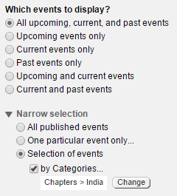
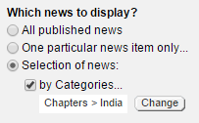
Configure your Chapter Home, Chapter News and Chapter Events Pages
Chapter News
Chapter Events
Click the Pages menu
Navigate to your Chapter Page
Find the News widget, blue bar and click Edit
Choose your chapter name from Selection of news by Categories
Click the Pages menu
Navigate to your Chapter Page
Find the Events widget, blue bar and click Edit
Choose your chapter name from Narrow selection, Selection of events by Categories
You may need to set the List Settings and Singe Item Settings on the Chapter News and Chapter Events pages

Slide 19
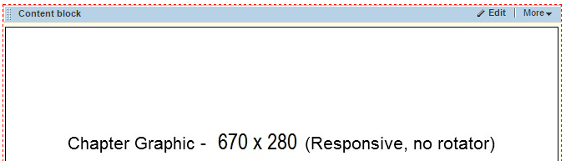
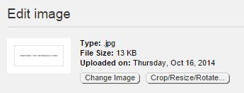
Updating the Chapter Graphic
The Dimensions for the Chapter Graphic should be 670 x 280
Click the Edit link to modify the Content Block
Although you can delete the graphic and insert a new graphic, it may be faster to Right-Click the graphic and choose Properties
Click the Change Image button and select the image you uploaded in your Chapter Image Library
Modify the Title and Alternate Text with an appropriate phrase. Do not use words like Image or Logo
Click Save to return to the Content Block and click Save again to return to the Page

Slide 20




Modifying Content on the Chapter Page
Update your Chapter Name content block, click Edit
Before clicking Save, it may be helpful to click HTML to review the code behind your text and verify that extra tags were not inserted by mistake
Click Design to return, then click Save
Click the More formatting options button
Buttons such as Hyperlink Manager, Image Manager, Paste from Word, Document Manager, Format Stripper and Toggle Full Screen Mode can be very helpful
Click Publish when you are done editing the page

Slide 21
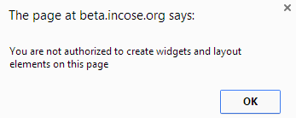
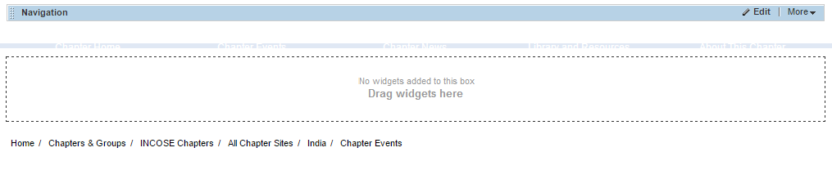
Current Problem with Chapter Templates Soon to be Resolved
There are some areas within the Chapter Templates that prompt to Drag widgets here although your current Admin login does not allow you to modify the template.
This is a problem we hope to resolve with all of the Chapter templates soon. But for your immediate needs, please contact INCOSE Central directly with the URL of the page you are having problems with and we will be happy to fix the problem.

Slide 22
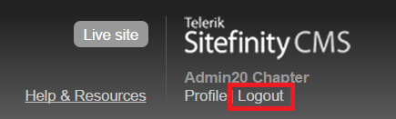
After you are done, before closing your browser, please Logout
INCOSE is licensed to have only 10 concurrent users modifying pages in Sitefinity at a time. Due to this license limitation, it is critical that you LOG OUT when done so others are not locked out.

Slide 23
Thank you!
I hope you are as excited about our new IT platform as I am!
If you have any questions or concerns about what was covered in this session, please contact INCOSE Central directly or email
IT-Eval@incose.org

